Slide 1
Point mass dynamics of missile

Slide 2
Basic Assumptions for Point Mass Model
Equations are written in flat and non-rotating earth
All forces act at the CG of the airplane
Acceleration due to gravity (g) is assumed to be function of altitude
Atmosphere is at rest relative to earth
Atmospheric properties are functions of altitude only
Forces acting on missile are thrust, aerodynamic forces and its weight
Vehicle attitude is ignored, only direction of velocity vector is considered.

Slide 3
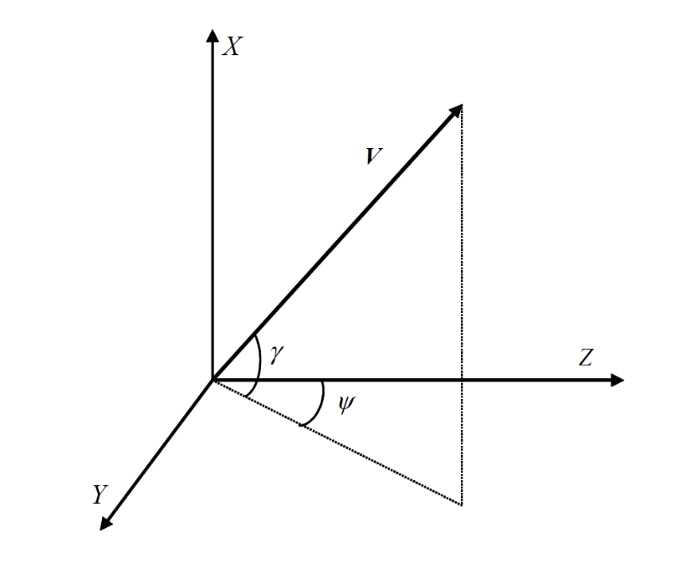
Point mass 3-D model

